Slide 1


Fast, Secure and Not Annoying Smart Wallet Protocol on Solana
By the very serious Kronus Team

Slide 2
Kronus is an Annoying-Free Smart Wallet Protocol for Solana
~ 李乐 Le, Senior Software Architect, Kronus

Slide 3
No more repeatedly clicking
annoying wallet popups

Slide 4
How the
Kronos Protocol
works

Slide 5
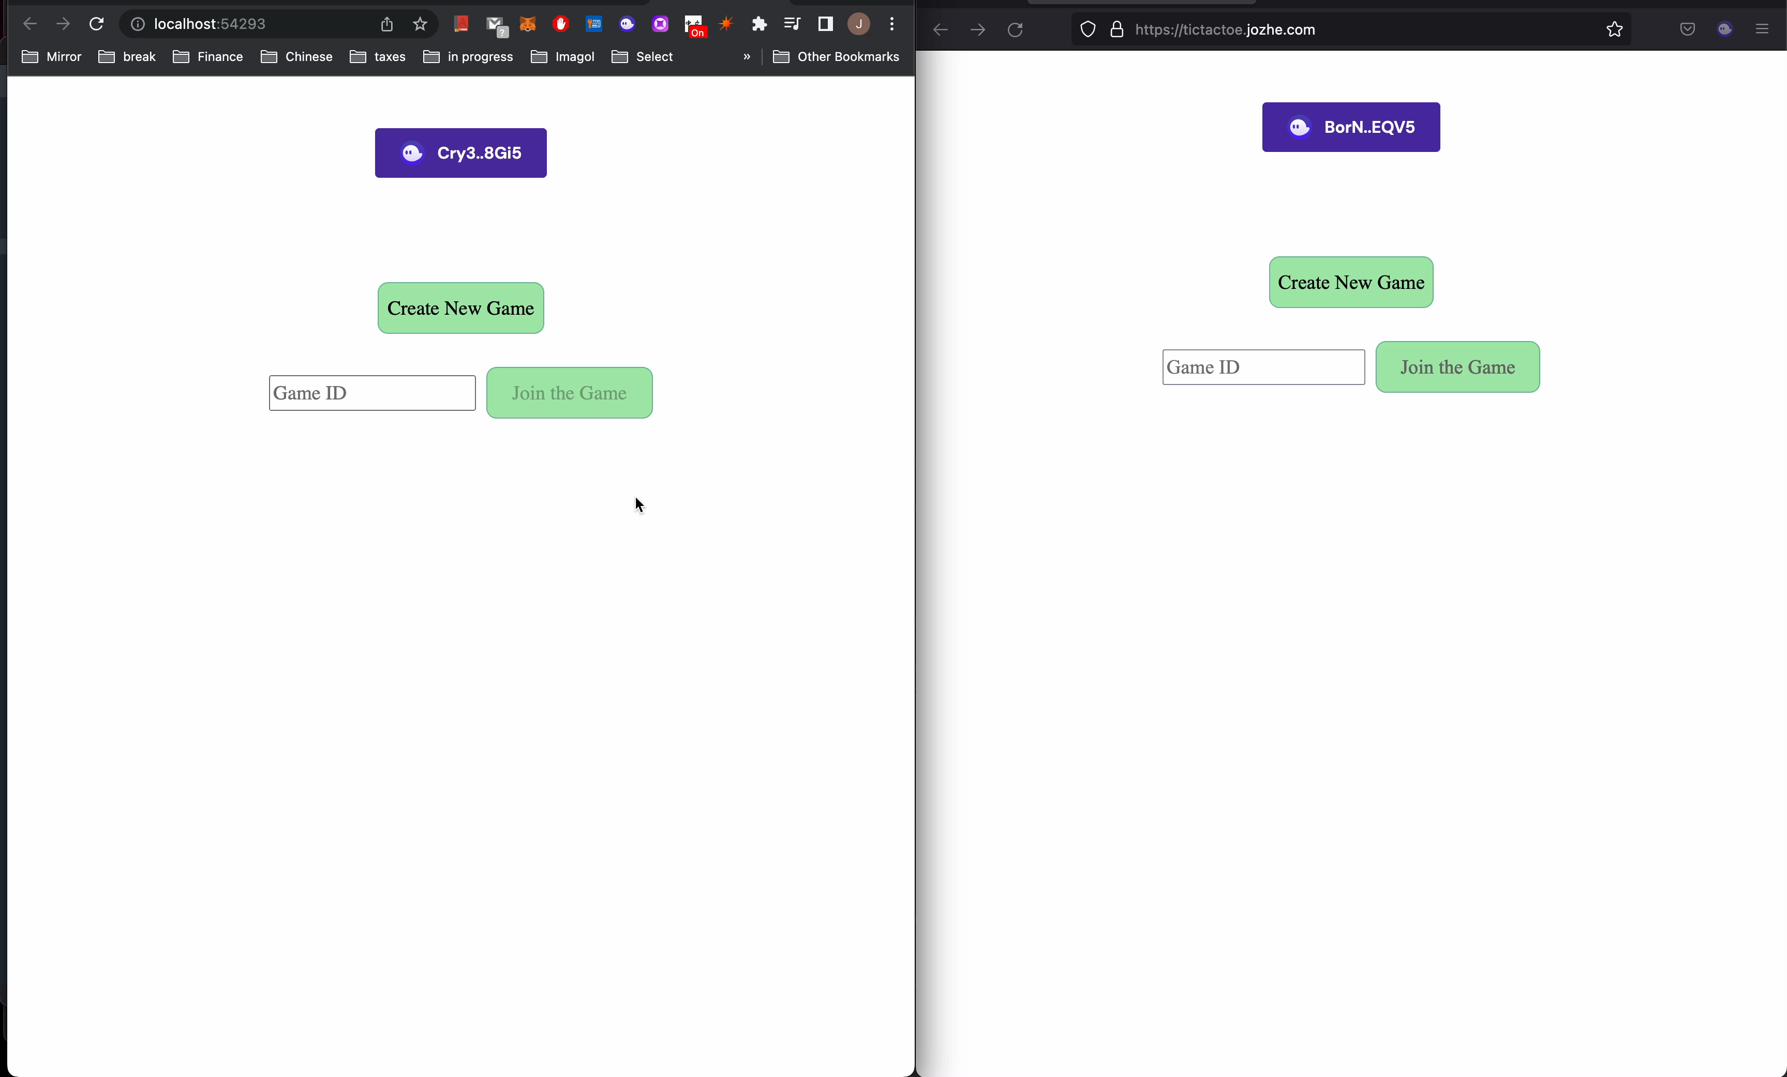
Demo : Tic-Tac-Toe Game UI
No Kronus
With Kronus
On the left-hand-side, the player suffers through clicking the annoying popup for every action on the chain.
On the right-hand-side, the player delightfully plays through the tic-tac-toe game. No popups :D

Slide 6
Demo : Tic-Tac-Toe Game Logs
Log streams from Solana show each players actions for player 1 and player 2

Slide 7
Kronus Protocol Flow
User authorizes Kronus
SW key-pair generation
via Kronus Service
Delegation of signing authority
Confirmation of TX
SW sends TX to Solana
User performs action. Delegated SW signs TX
MW invalidates
SW and revokes authority
End session

Slide 8
Features
// 1. Import Kronus `Delegate`
// macro in your Anchor program
use anchor_lang::prelude::*;
use kronus_protocol::Delegate;
// 2. Mark your accounts as a Delegate
// candidate account with the `Delegate`
// macro
//
// - It allows the `Create` instruction to
// to be signed by a delegate authority.
#[derive(Accounts, Delegate)]
pub struct Create<'info> {
#[account(init, payer = user, space = 16 + 16)]
pub base_account: Account<'info, BaseAccount>,
#[account(mut)]
pub user: Signer<'info>,
pub system_program: Program<'info, System>,
}
// An account that goes inside a transaction
#[account]
pub struct BaseAccount {
pub count: u64,
}
Bring Your Own
Contract
Kronus Macros
Build Kronus seamlessly into your
Smart contracts with our
Library of Rust Macros

Slide 9
Bring Your Own
Contract
Kronus Macros
Build Kronus seamlessly into your
Smart contracts with our
Library of Rust Macros

Slide 10

Cross-platform
Support
Helm
Kronus is able to function in fully
decentralized applications, and
Centralized applications

Slide 11
Kronus Use Cases
Gaming dApps
Decentralized Marketplaces
DeFi

Slide 12
Business Model
Micro-TX
commissions
Volume Based
Pricing
Kronus charges a small micro-fee of
10% of the gas fee per transaction
First 10,000 TX Free per app
$1000 per 100,000 MAU per month.

Slide 13
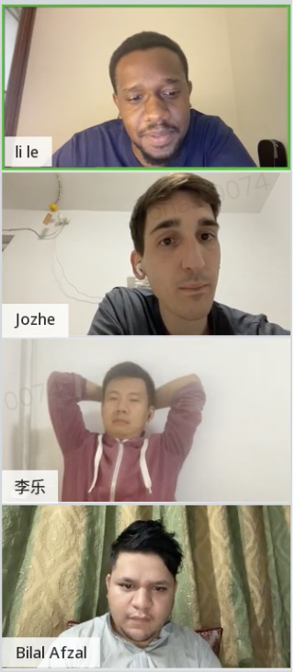
Team
Jonas
李乐 Le - Chief 外卖 Officer
Jozhe - Chief 胡同 Officer
Bilal - Chief Blockchain Officer
Jonas - Chief 胡同-Parking Officer
Jozhe
李乐, Le
Bilal

Slide 14
kronus.to

